Slide 1



PEOPLE ONBOARDING AND MANAGEMENT

Slide 2

CUSTOMIZATION FOR BEST UTILIZATION!

Slide 3
1
2
3
4
ADDRESS STYLE
NAME FORMAT
PERSON TYPES
LOOKUPS
5
6
7
SPECIAL INFO TYPE (SIT)
EXTRA INFO TYPE (EIT)
MEDICAL ASSESSMENT

Slide 4
1
PERSON TYPES

Slide 5

This categorizes people to employees, applicants, candidates, referrals, etc.
Each company can customize its own list
HRMS > Other Definitions > Person Types

Slide 6
Add Person Type Name

Slide 7
2
LOOKUPS

Slide 8
HRMS > Other Definitions > Application Utilities Lookups
Press Ctrl + F11 to look for the lists you want to edit/customize
For example, search for Nationality

Slide 9
Or Marital Status

Slide 10
3
ADDRESS STYLE

Slide 11
Remember Business Group Location?
Create Descriptive Flexfield
System Administrator > Application > Flexfield > Descriptive > Segments
Application: Human Resources – Personal Address Information

Slide 12
Add Segments
Save and press on Compile

Slide 13
4
Name Format

Slide 14
Last Name, First Name
First Name Last Name
First,
HRMS > Other Definitions > Person Name Formats
This opens a web page, press on Create Name Format button

Slide 15
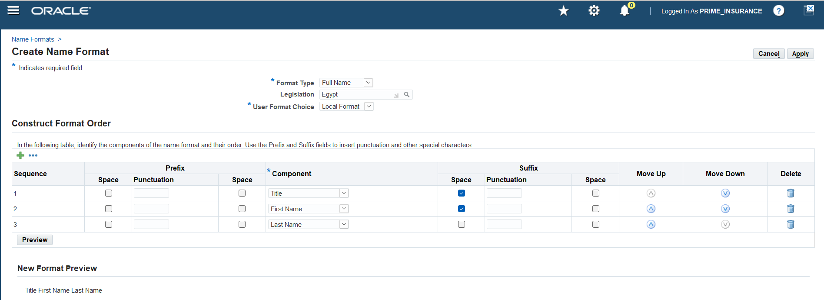
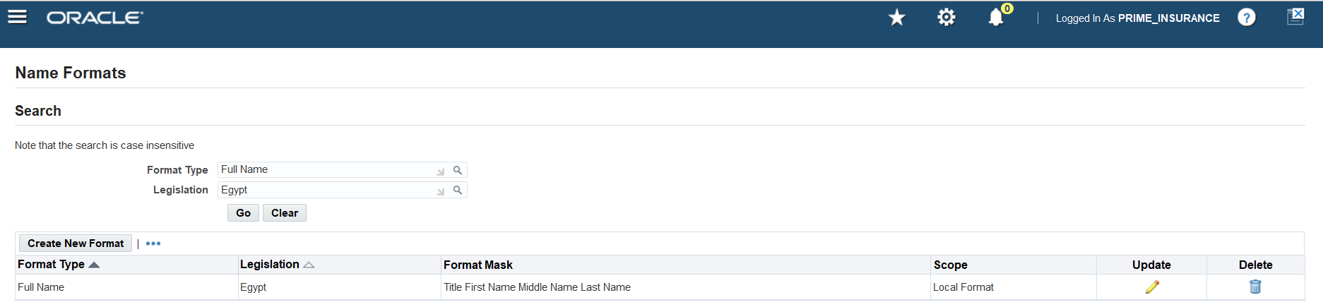
Choose the format and legislation
Create the sequence for the name format

Slide 16
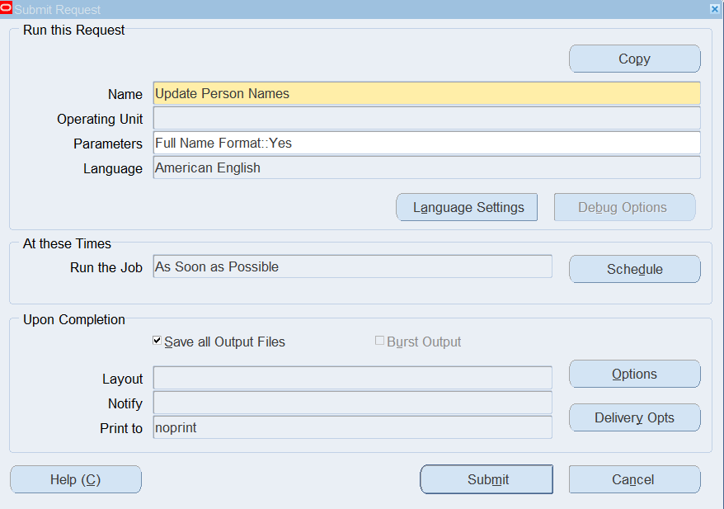
Second,
View > Requests > Submit a New Request
Name: Update Person Names
Format Type: Full Name Format

Slide 17
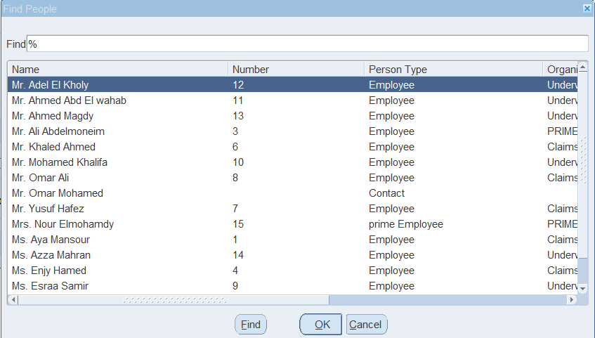
Once request is completed, the new format shall be applied already

Slide 18
5
SPECIAL INFO TYPE (SIT)

Slide 19
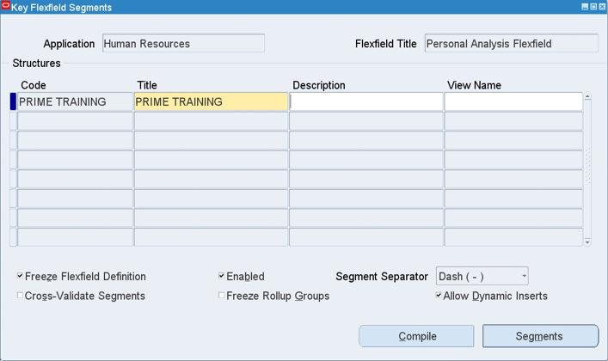
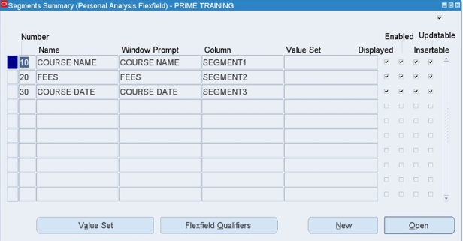
There are 2 steps to set up Special Information Type
1. Create Key Flexfield
System Administrator > Application > Flexfield > Key > Segments
Application: Human Resources - Personal Analysis Flexfield

Slide 20
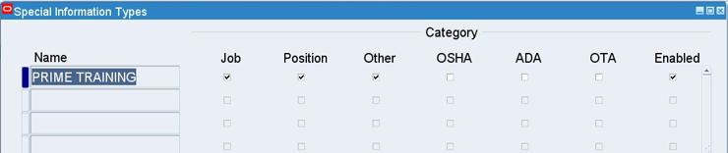
2. Choose which windows this flexfield should appear on
HRMS > Other Definitions > Special Information Type

Slide 21
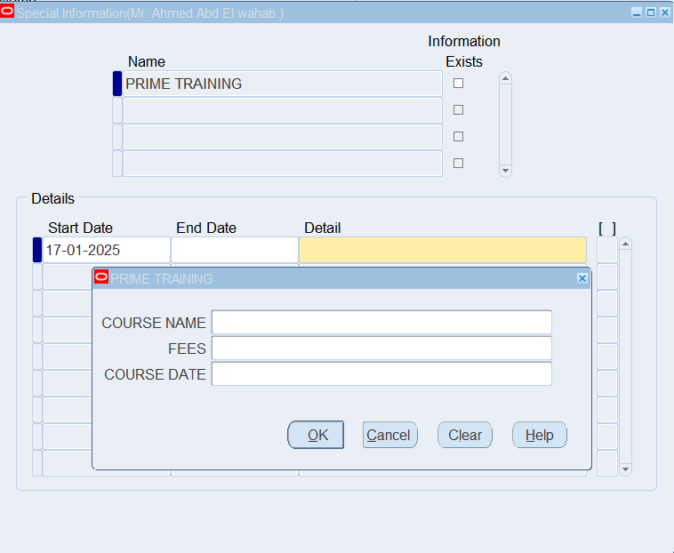
Special Information Type appears here:
HRMS > Work Structure > Job > Description > Requirements Button
HRMS > Work Structure > Position > Description > Others Button > Requirements
HRMS > People > Enter and Maintain > People Window > Special Info Button

Slide 22
6
EXTRA INFO TYPE (EIT)

Slide 23
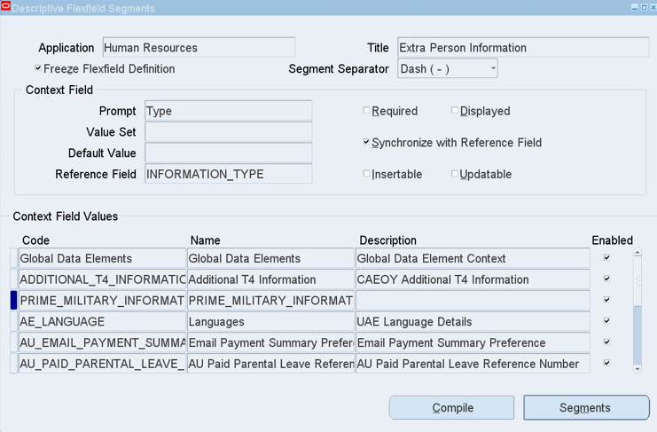
There are 3 steps to set up Extra Information Type
1. Create Descriptive Flexfield
System Administrator > Application > Flexfield > Descriptive > Segments
Application: Human Resources - Extra (Person/Assignment/Job/etc.) Information

Slide 24
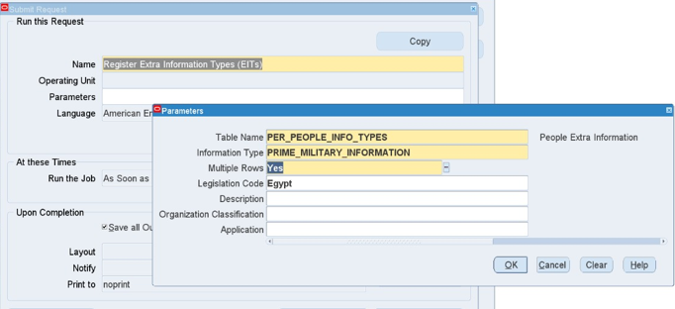
2. Run Request
View > Requests > Submit a New Request
Name: Register Extra Information Type
Parameter: Extra Information - window DFF was created for (People/Assignment/Job/etc.)

Slide 25
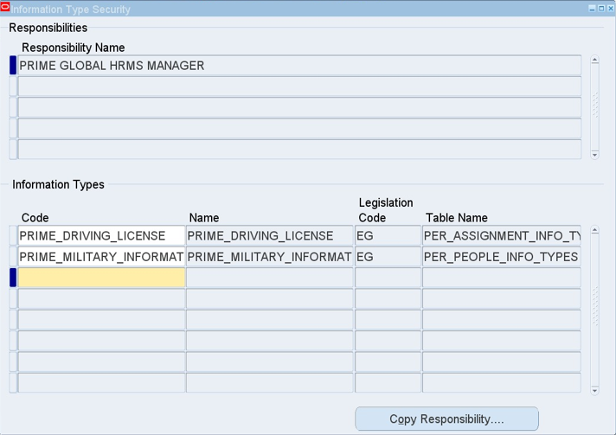
3. Assign to Responsibility
HRMS > Security > Information Types Security
F11 to search for Responsibility Name
Information Types:
F11 to search for created descriptive flexfields

Slide 26
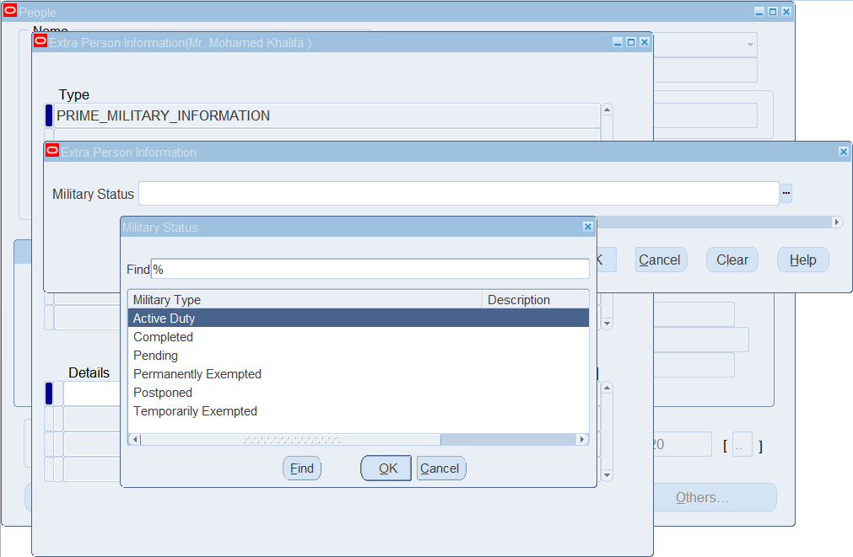
The one created for People shall appear in People window
People Window > Others Button > Extra Information

Slide 27
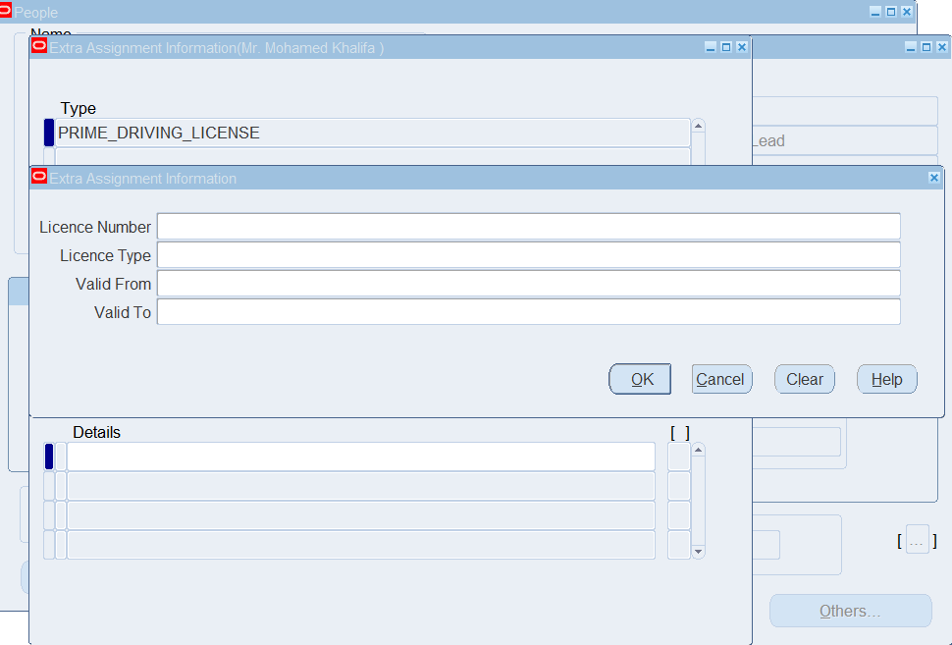
and the one created for assignment shall appear in Assignment window
People Window > Assignment Button > Others Button > Extra Information

Slide 28
7
MEDICAL ASSESSMENT

Slide 29
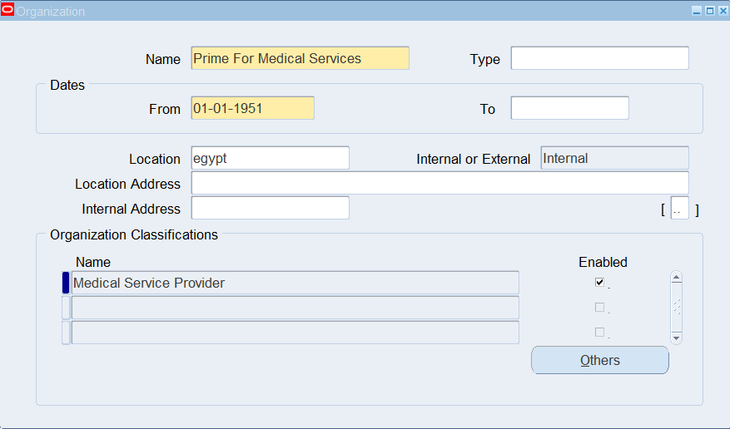
Define Medical Provider Organization
HRMS > Work Structures > Organization > Description
Add Organization Name
Classification: Medical Service Provider

Slide 30
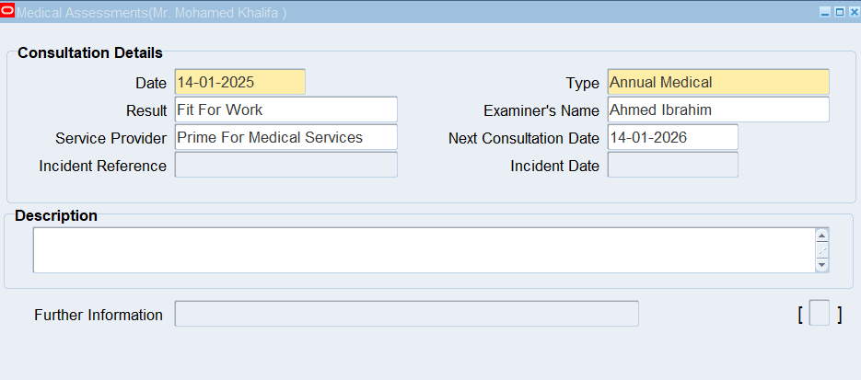
To add it to employees:
HRMS > People > Enter and Maintain > People Window > Others Button > Medical Assessments

Slide 31

CREATE EMPLOYEE PROFILE!

Slide 32
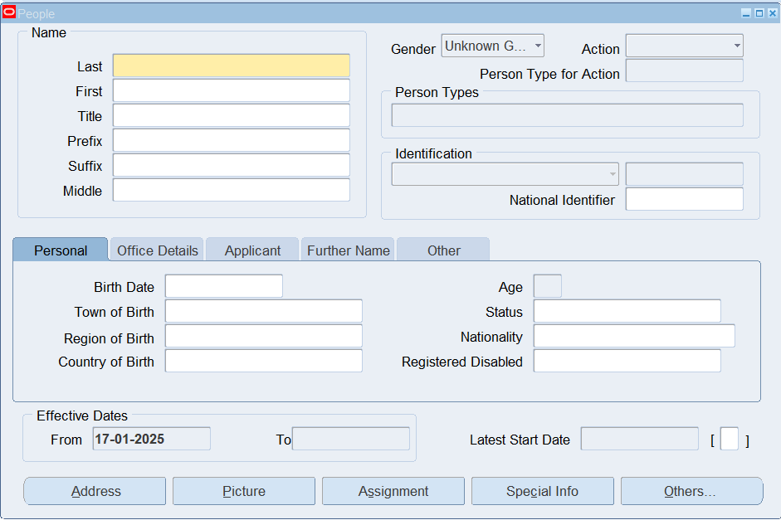
HRMS > People > Enter and Maintain > New
Fill out personal information

Slide 33
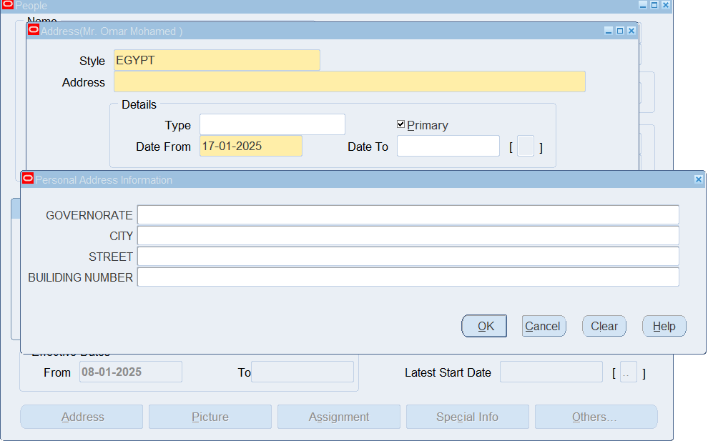
Address Button

Slide 34
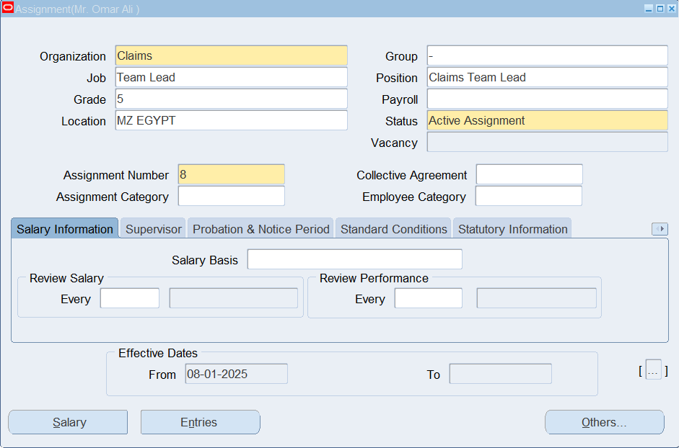
Assignment Button

Slide 35
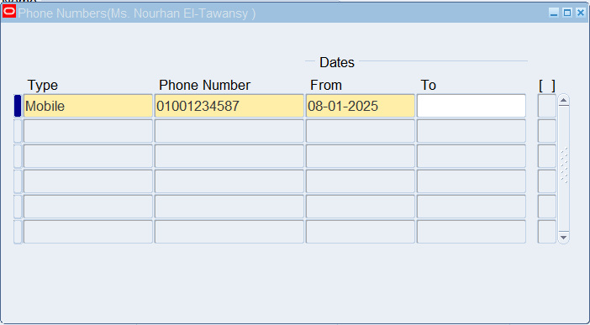
Others Button > Phones

Slide 36
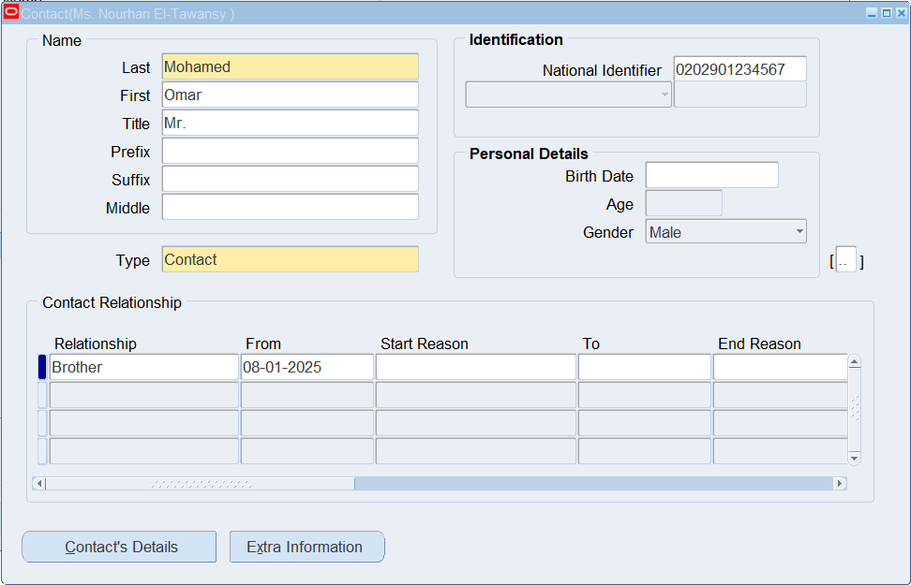
Others Button > Contact

Slide 37
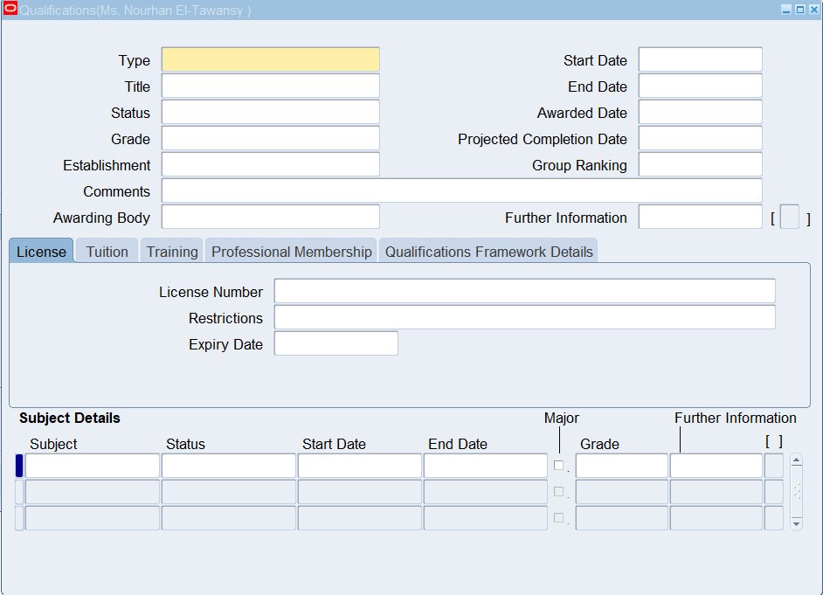
Others Button > Qualifications

Slide 38
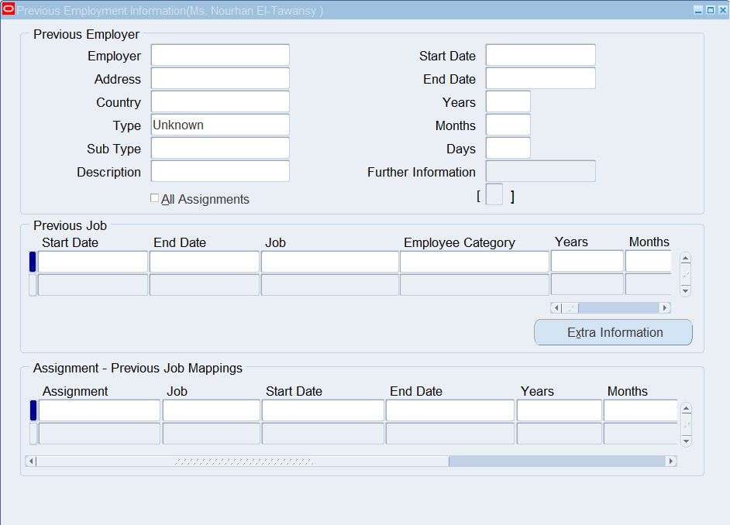
Others Button > Previous Employment

Slide 39
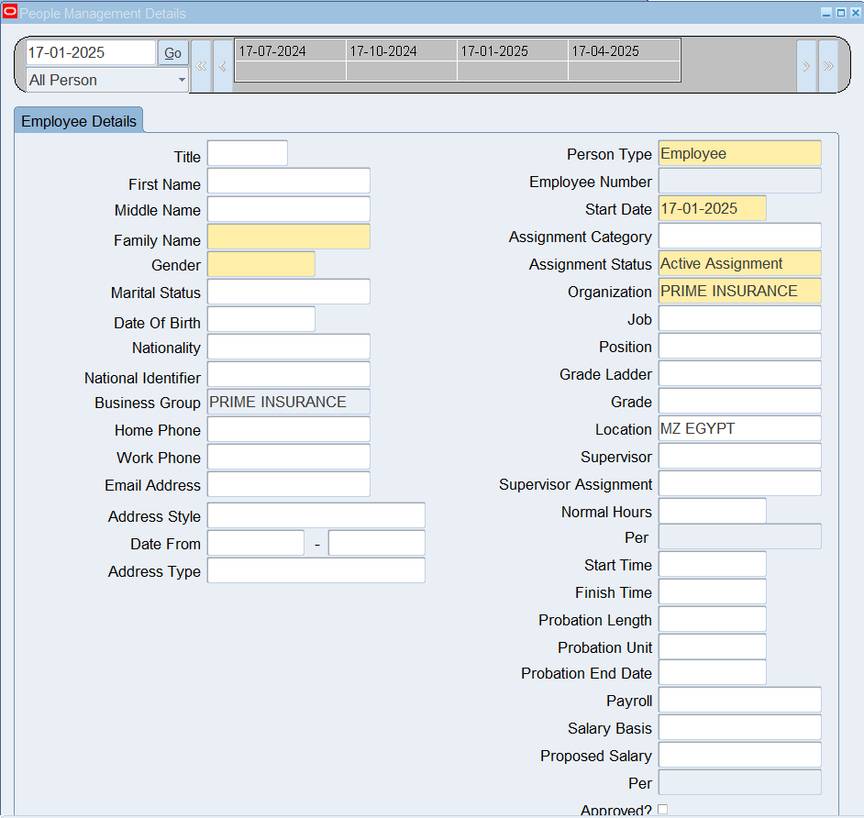
Create an Employee Using Templates
HRMS > People > Maintain Using Templates > Entering Employees
To edit profiles:
HRMS > People > Maintain Using Templates > Maintaining Employees

Slide 40
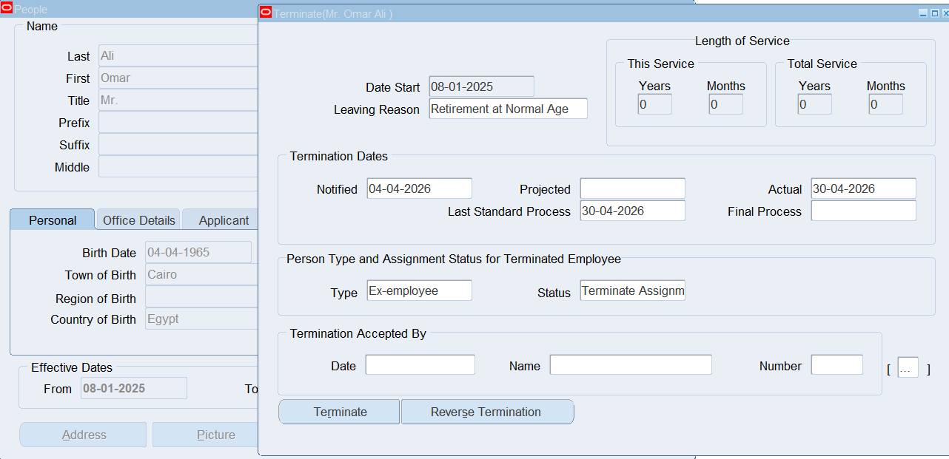
People Window > Others Button > End Employment

Slide 41
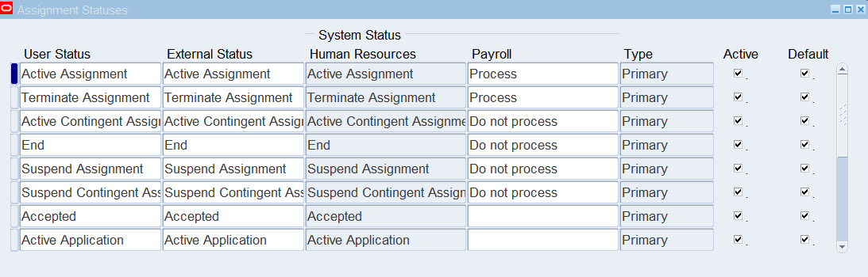
Assignment Status
This can also be customized based on the statuses the company is categorizing its employees by
HRMS > Work Structures > Status
Press on +New icon to add a new assignment status

Slide 42
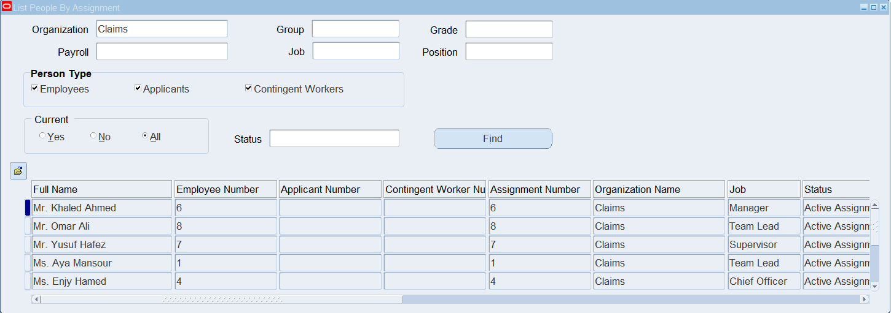
View Lists
HRMS > View > Lists > People by Assignment

Slide 43

PAYROLL MANAGEMENT

Slide 44
1
2
3
4
Define Consolidation Set
Egypt Legislation
Bank Details Flexfield
Define Monetary Unit
5
6
7
Define Payment Type
Define Payment Method
Define Payroll

Slide 45
1
Egypt Legislation

Slide 46
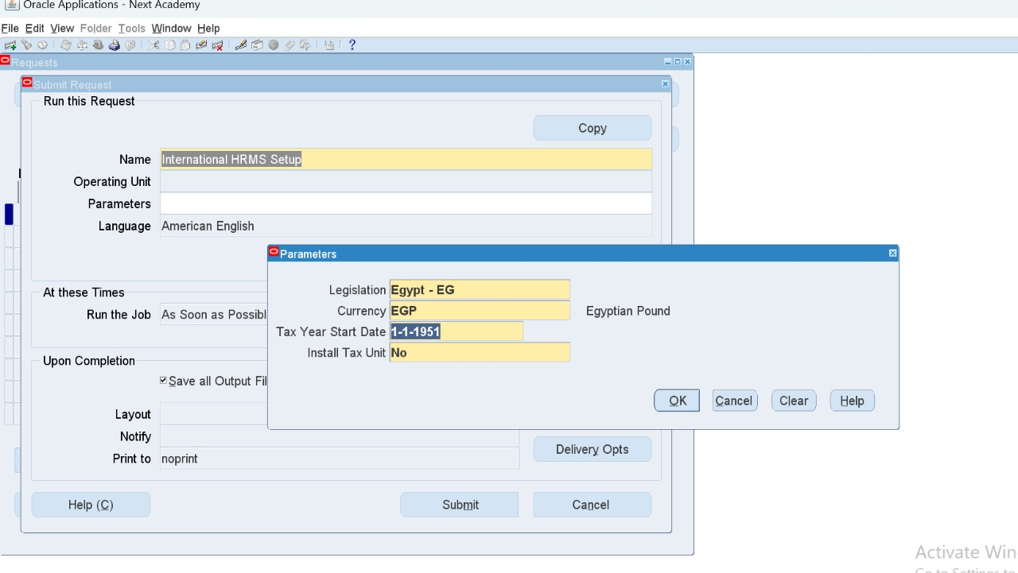
HRMS > View > Requests
Request Name: International HRMS Setup

Slide 47
2
Bank Details Flexfield

Slide 48
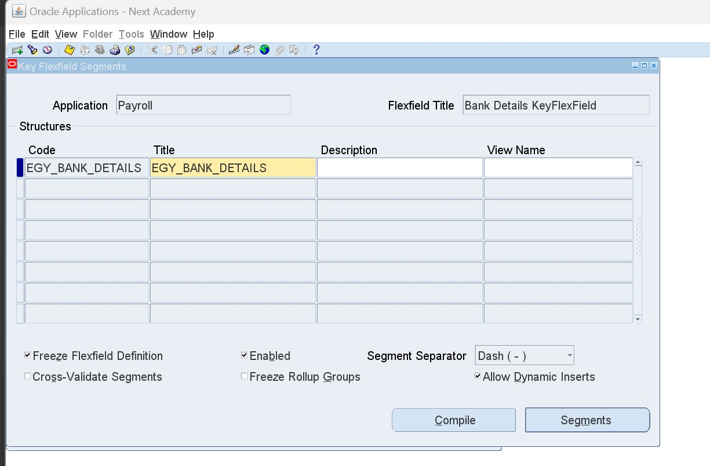
Bank Details flexfield is standard
Sysadmin > Application > Flexfield > Key > Segments
Application: Payroll - Bank Details KeyFlexField (EG_Bank_Details)

Slide 49
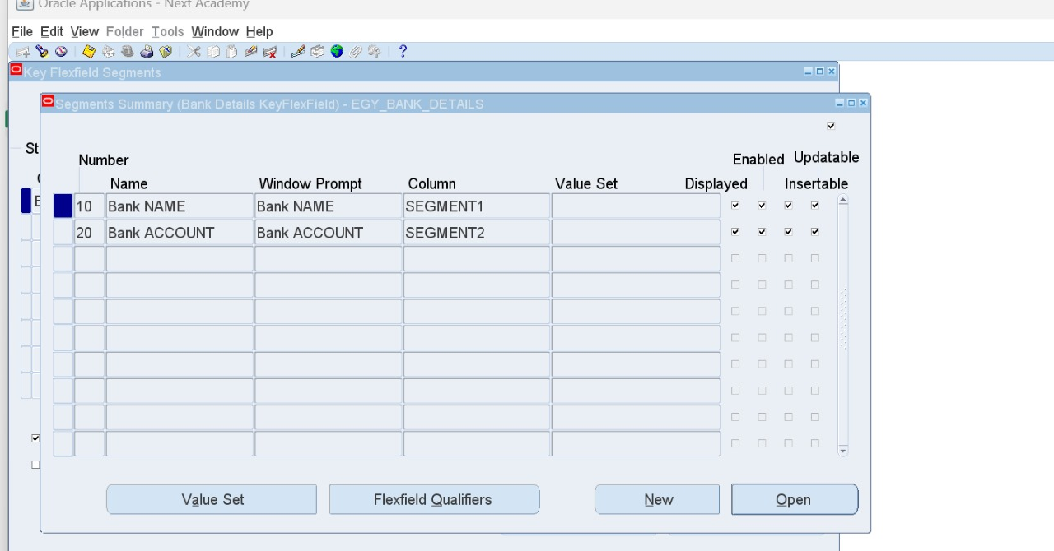
Add the needed segments

Slide 50
3
Define Monetary Unit

Slide 51
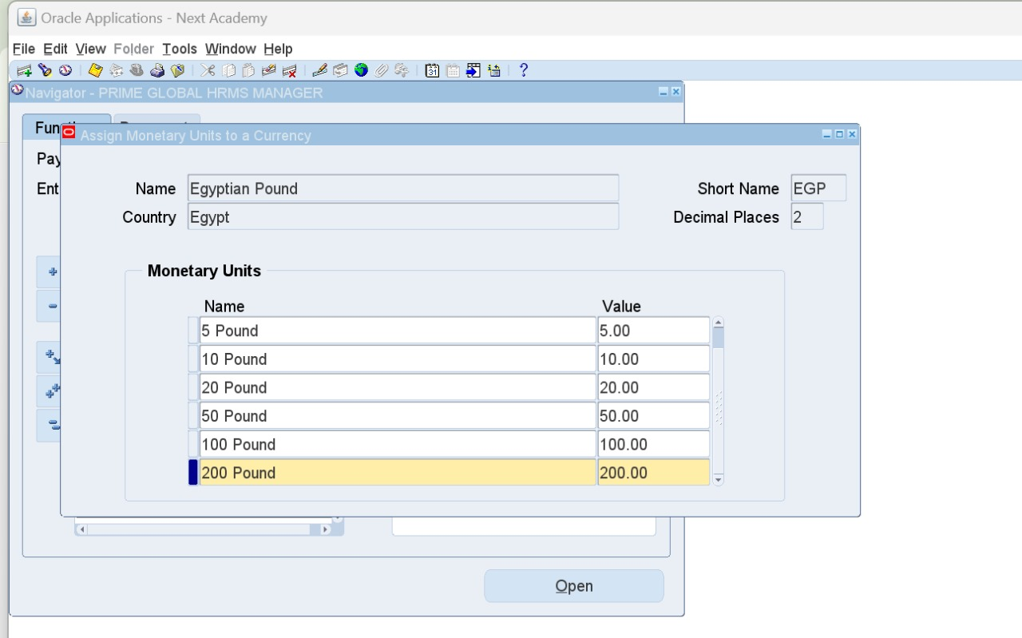
HRMS > Payroll > Monetary Units
Find Currency: EGP then add units 5,10,20,50,100,and 200

Slide 52
4
Define Consolidation Set

Slide 53
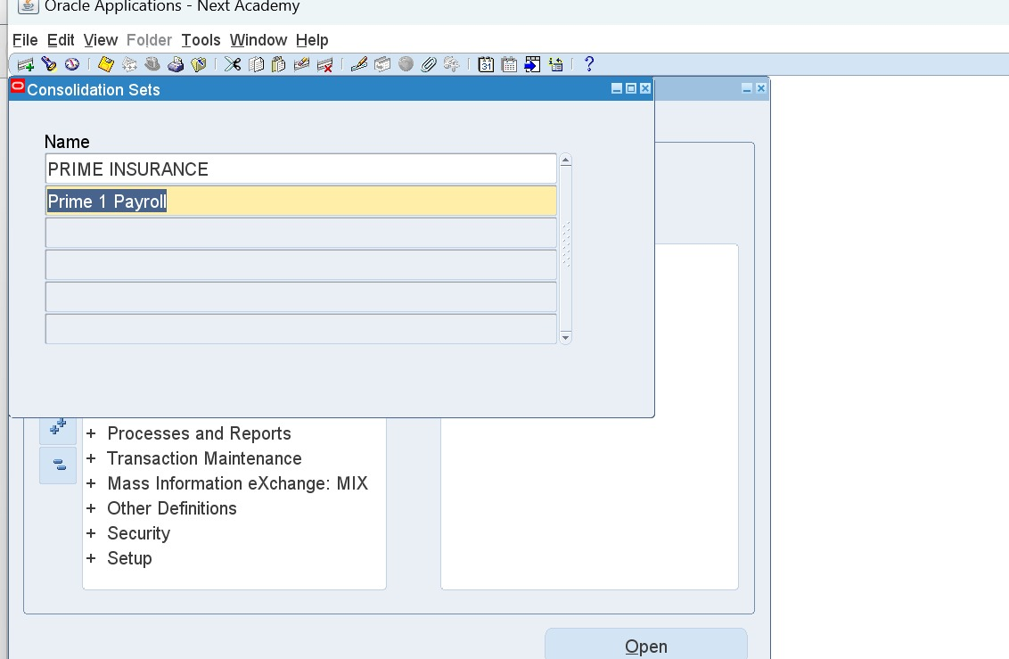
HRMS > Payroll > Consolidation
Name could be the same as Payroll Name or Assignment Set Name
Remember to alter date to BG creation date 01-01-1951

Slide 54
5
Define Payment Type

Slide 55
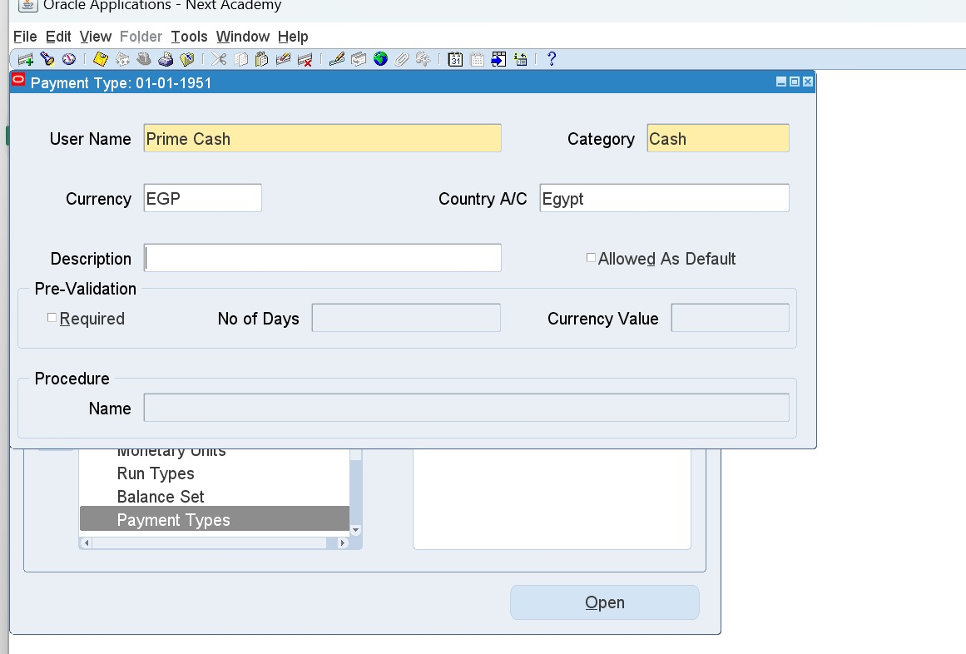
Payment Type is on Organizational Level
HRMS > Payroll > Payment Types
(CASH – CHECK – BANK)
To define Cash and Check, create them manually and choose the same category.

Slide 56
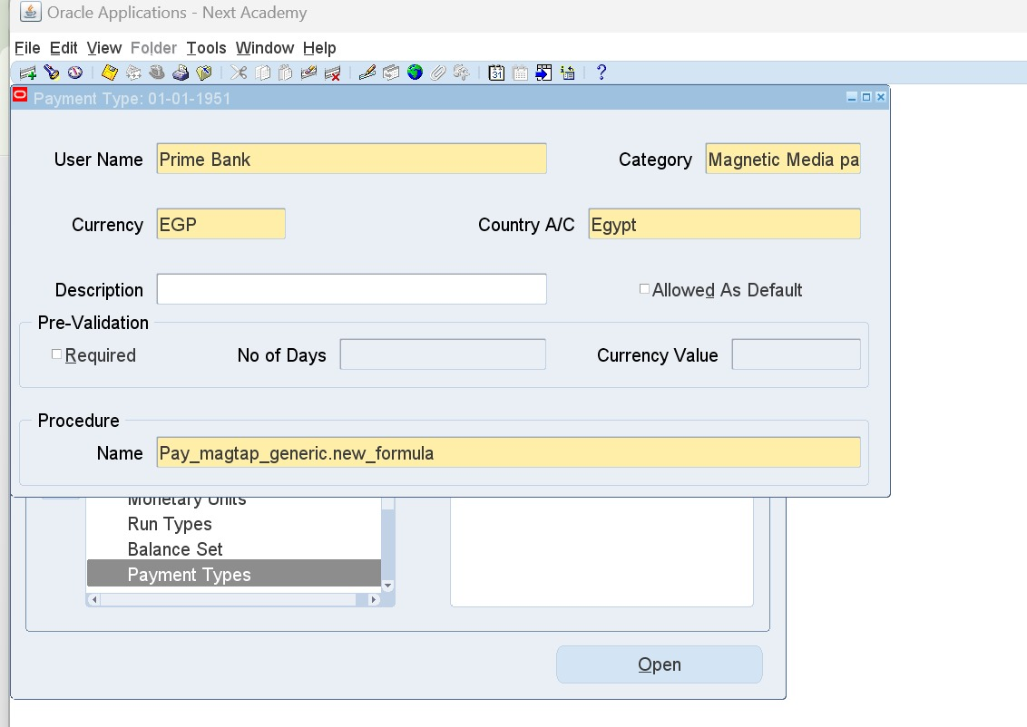
To define Bank Payment Type
F11 and search for %Bank%
Copy category and procedure name entries
Category: Magnetic Media payment
Procedure Name: Pay_magtap_generic.new_formula
Create a new bank definition with same details

Slide 57
6
Define Payment Method

Slide 58
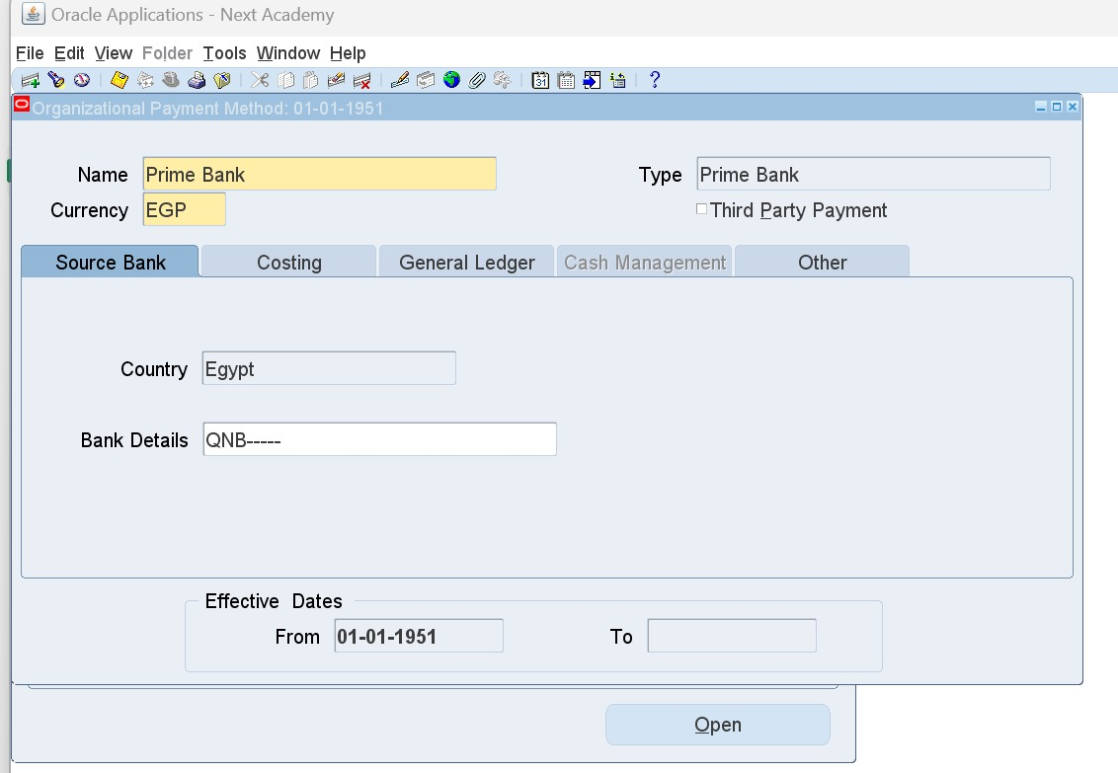
Payment Method is on Employee Level
HRMS > Payroll > Payment Methods
Add new method CASH, CHECK, and BANK
Type: Choose the predefined payment types
(Prime Cash – Prime Check – Prime Bank)
For Bank, make sure to fill out the bank details flexfields (employer’s).

Slide 59
7
Define Payroll

Slide 60
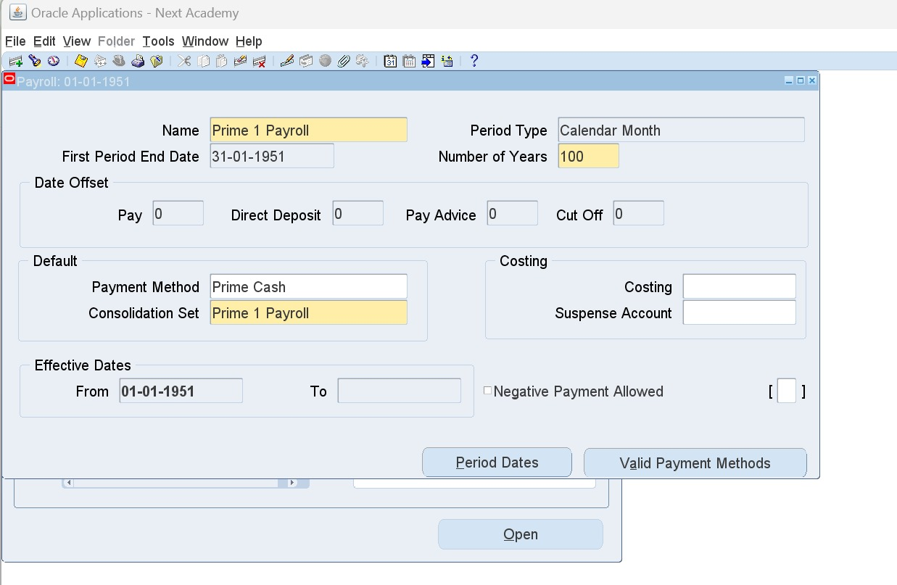
HRMS > Payroll > Description
Use same pre-defined Consolidation Set name
Period Type: Calendar Month
Number of Years: 100 years
Payment Method should always be CASH
Press on Valid Payment Methods to define the payment methods.

Slide 61
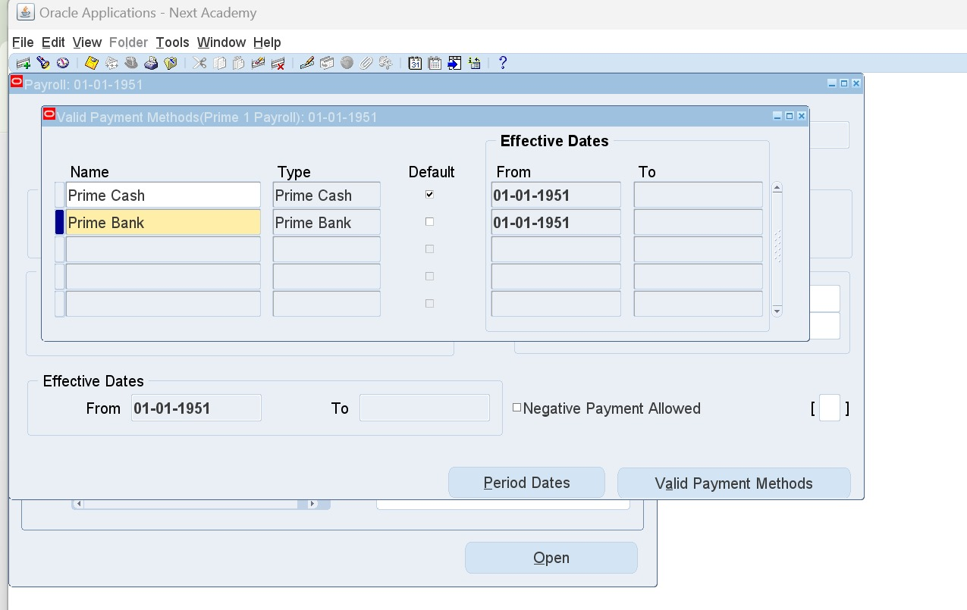
Valid Payment Method button:
Define the pre-defined payment methods (Cash - Check - Bank)

Slide 62
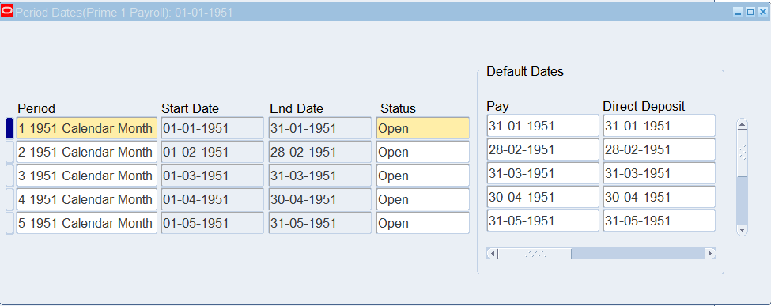
Period Dates button:
Shows all payroll cycles; end a payroll by changing the status to Closed

Slide 63
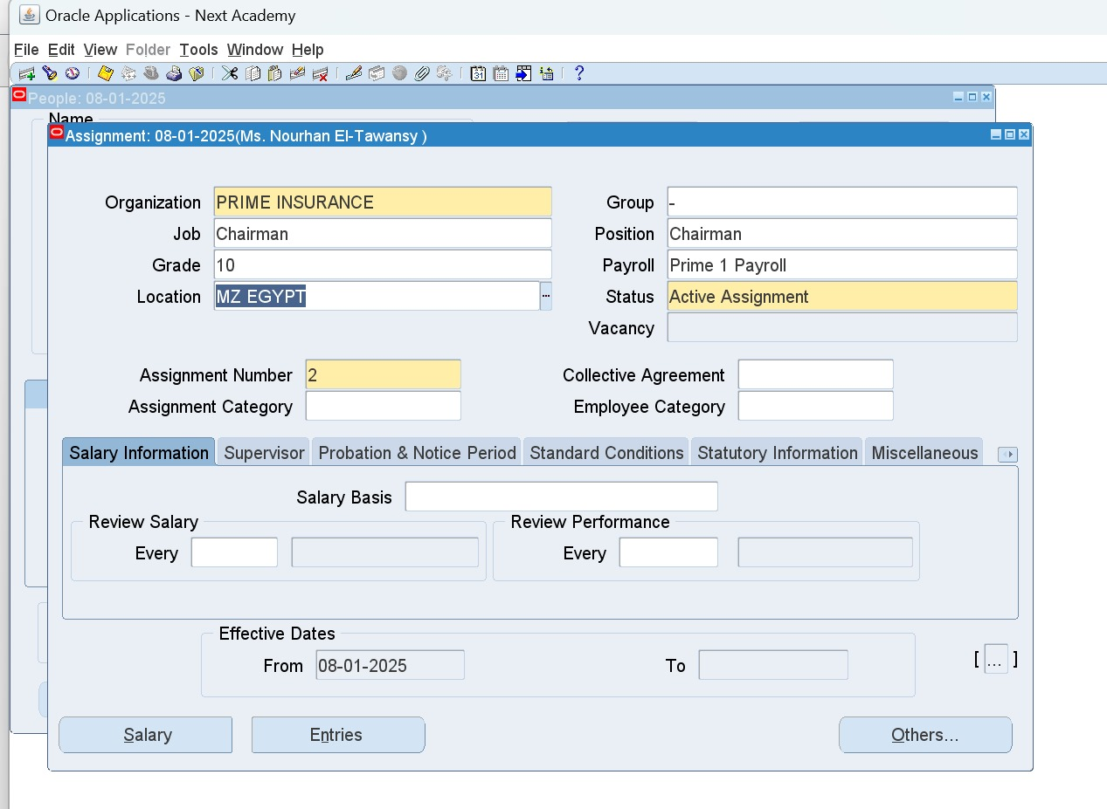
Assign Defined Payroll to Employees
HRMS > People > Enter and Maintain > People Window > Assignment button
Payroll Field

Slide 64

Elements

Slide 65
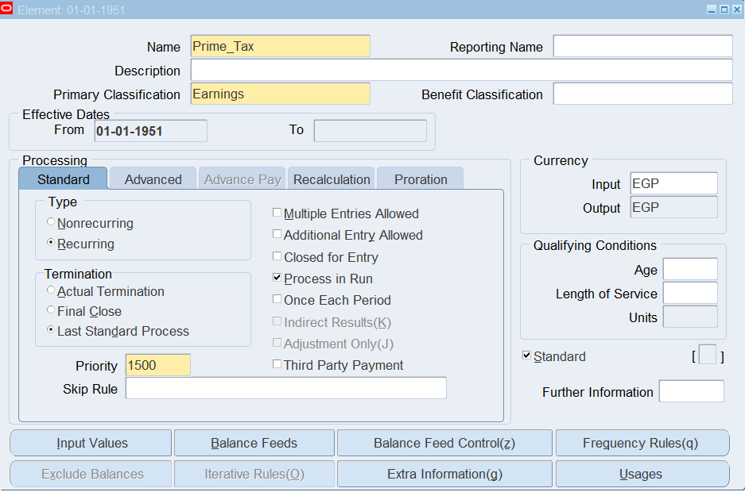
Elements Entries
HRMS > Total Compensation > Basic > Element Description
Element Primary Classification:
Earnings: Any added amount to the income.
Voluntary Deduction: Any requested deduction, Ex. Loan installments.
Involuntary Deduction: Any obligatory deductions, Ex. Tax.
Information: Any added allowances that is not translated into money, Ex. Housing. (Reporting Name should be added)

Slide 66
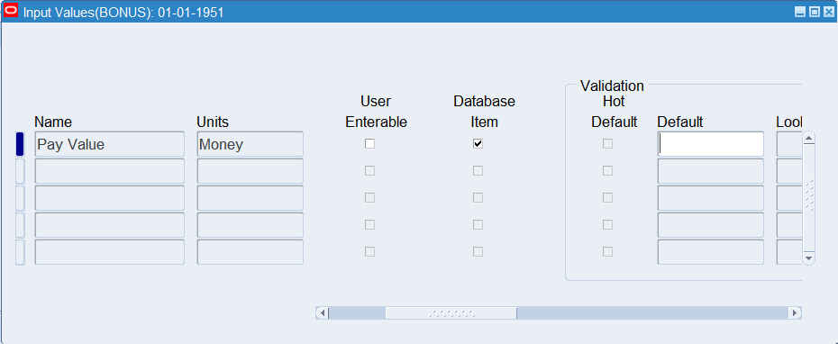
Save > Input Values Button
Uncheck User Enterable
Validation Hot Default

Slide 67
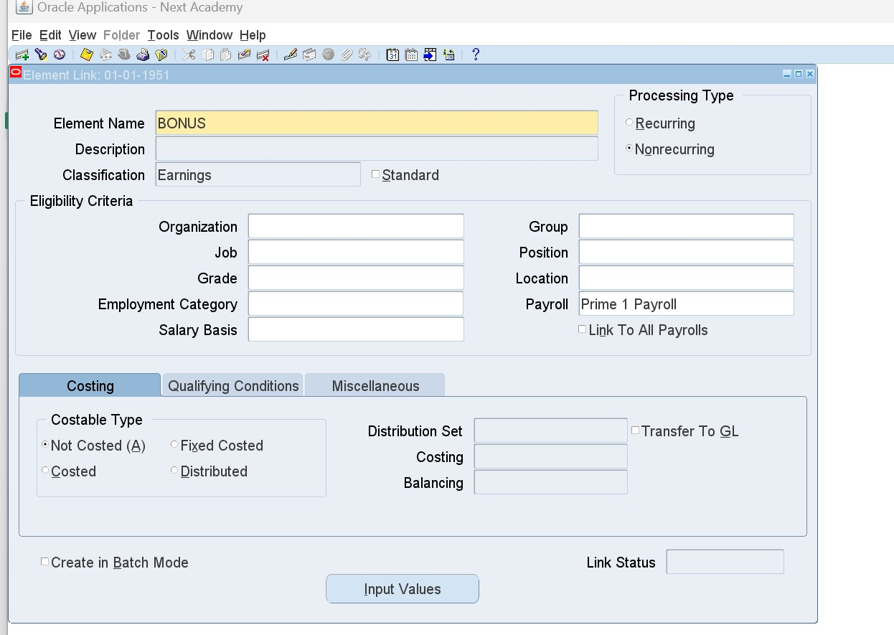
Elements Link
HRMS > Total Compensation > Basic > Link
Choose created element and its eligibility criteria
(leave them empty to apply to all)
To delete a link, press on the effective date in miscellaneous tab, press on delete icon, End Date.
To reactivate a link, press on end date in miscellaneous tab, press on delete icon, Next.

Slide 68
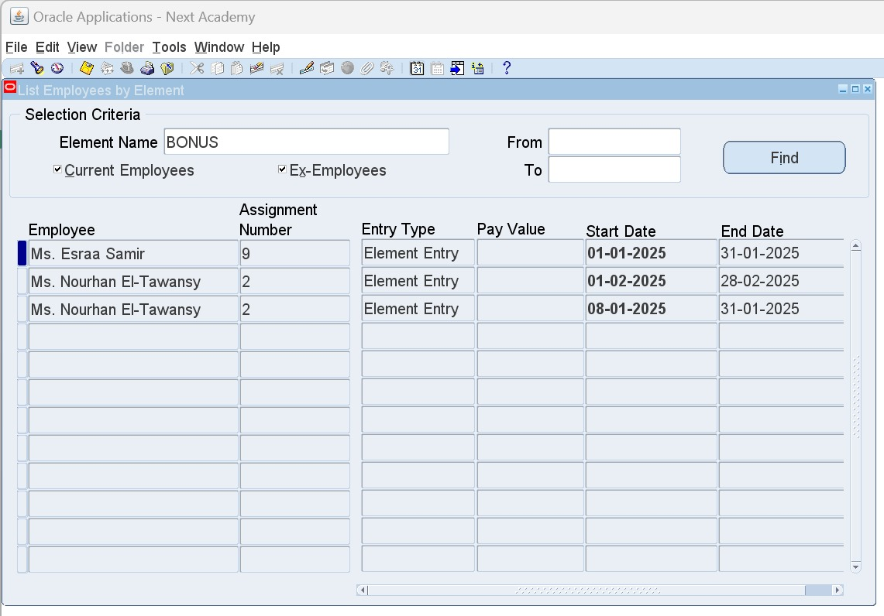
To delete an element, it should never be attached to any employee
HOW TO DELETE AN ELEMENT?
Firstly, list employees who are linked to it:
HRMS > View > Lists > Employees by Element
Search by element name to list all employees linked to it

Slide 69
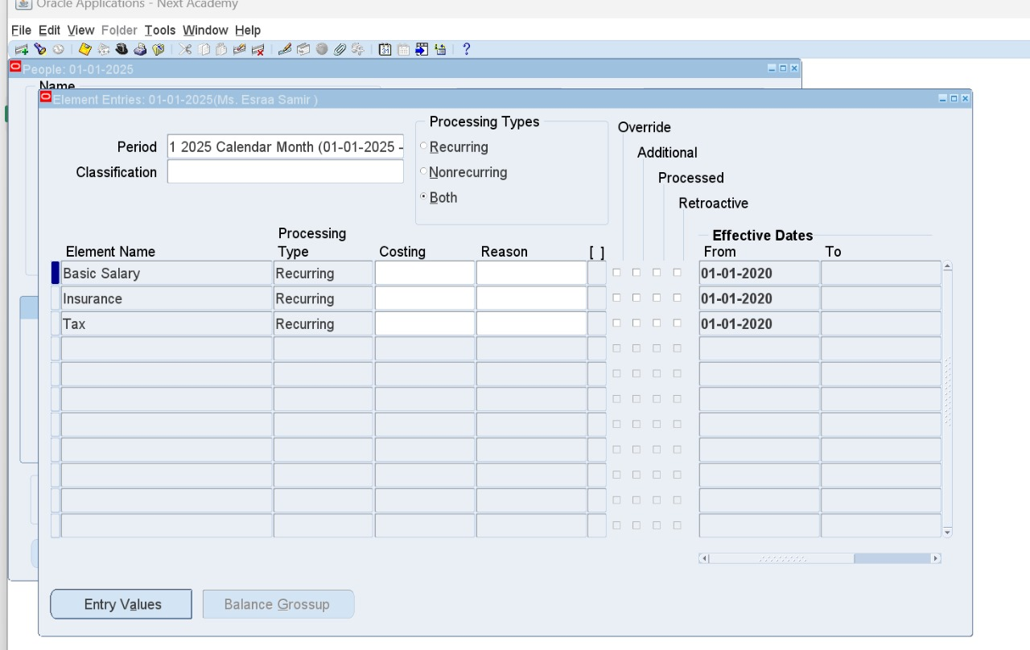
1. Delete Entries
HRMS > People > Enter and Maintain > Assignment Window > Entries Button
Select Entry - Delete icon - Choose "Purge"

Slide 70
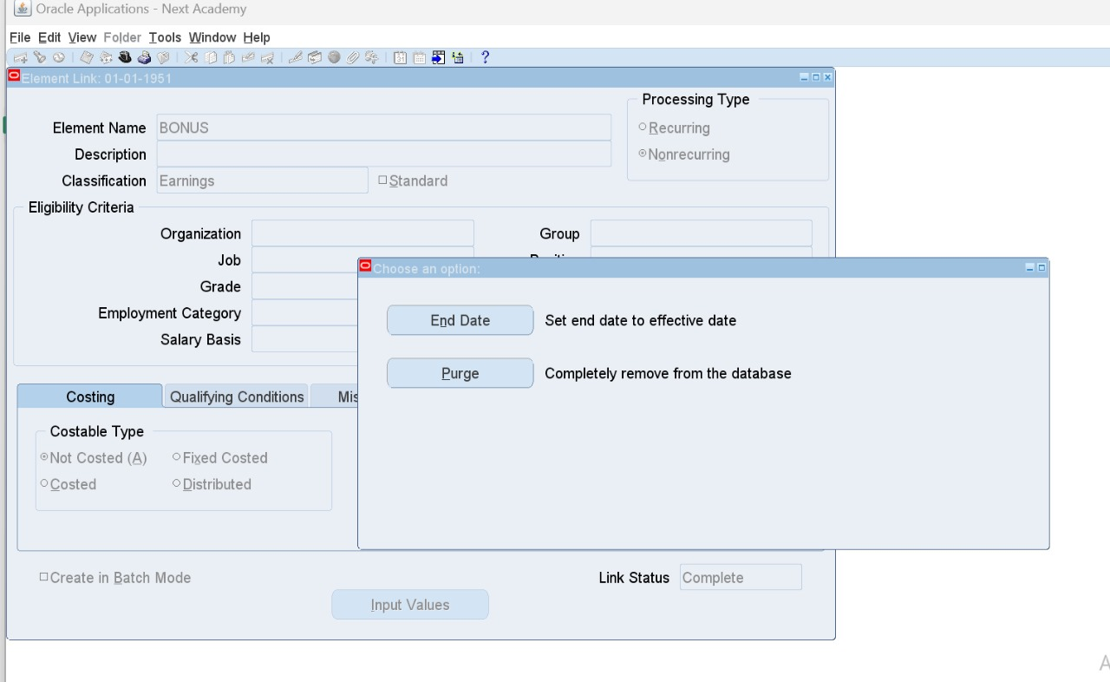
2. Delete Link
HRMS > Total Compensation > Basic > Link
Select Link - Delete icon - Choose "Purge"

Slide 71
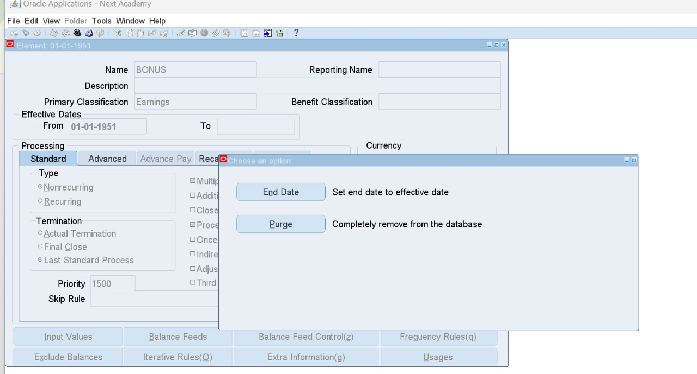
3. Delete Element
HRMS > Total Compensation > Basic > Element Description
Select Element - Delete icon - Choose "Purge“
(In case payroll got run choose End Date"

Slide 72

Salary Administration Setup

Slide 73
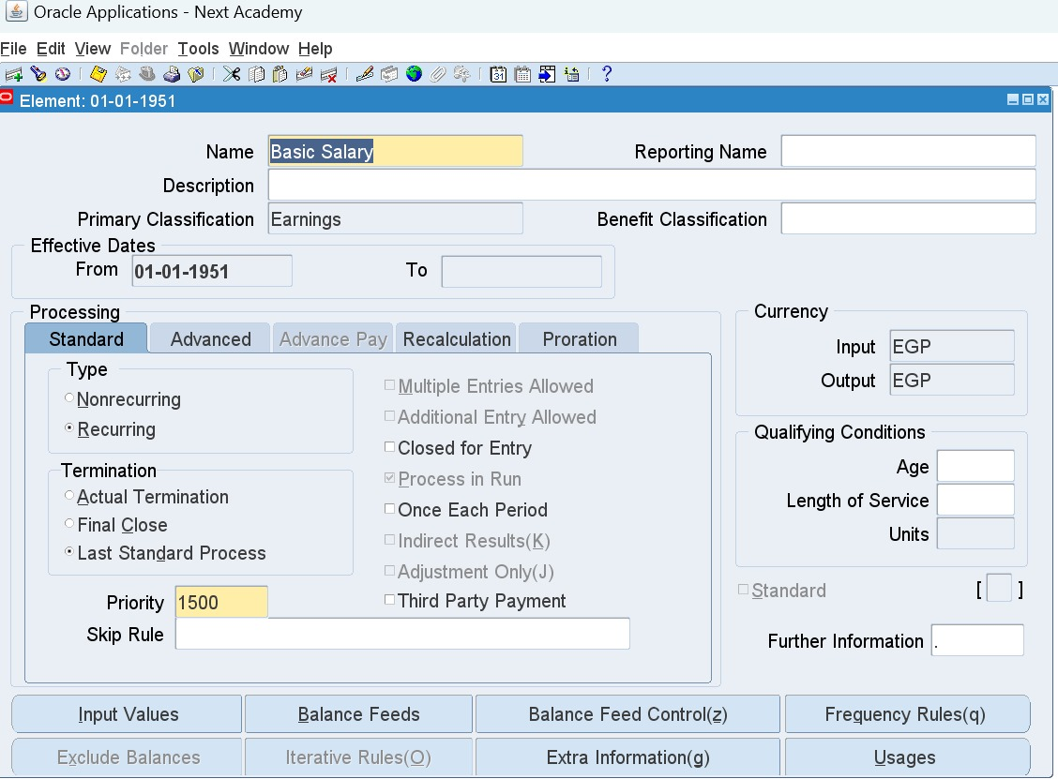
1. Create an element “Basic Salary”
HRMS > Total Compensation > Basic > Element Description
Uncheck User Enterable from Input Values window

Slide 74
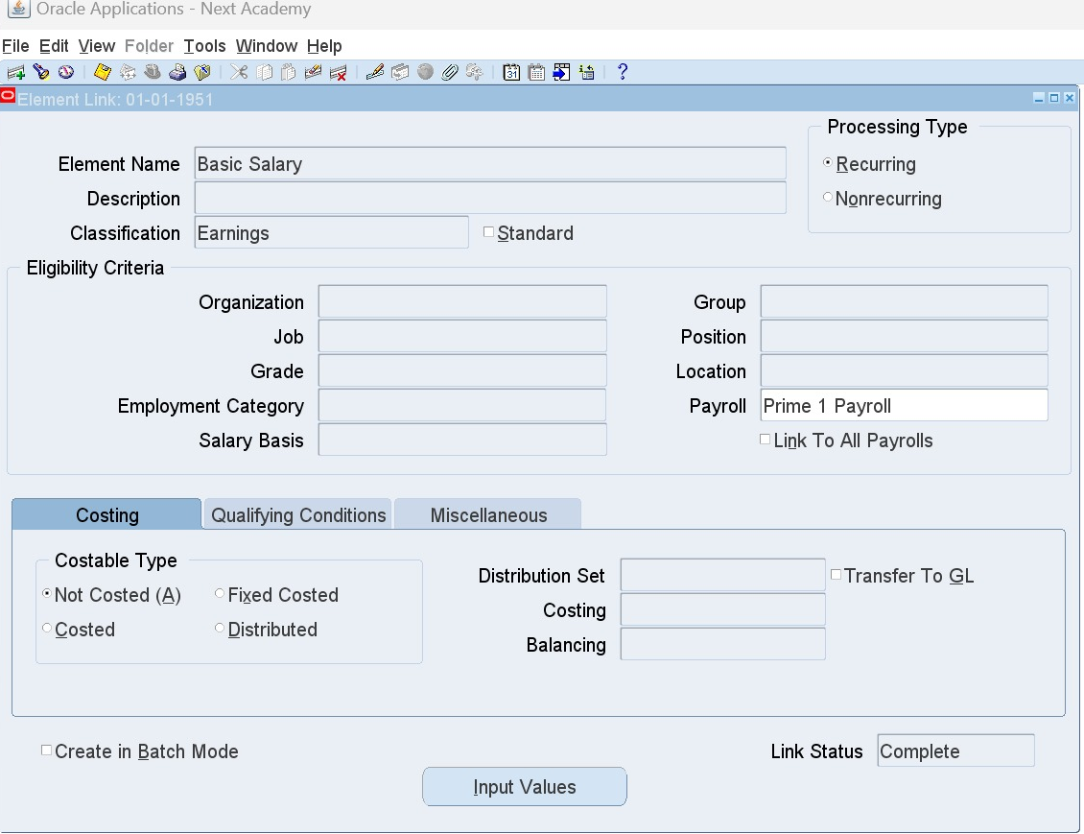
2. Add Element Link
HRMS > Total Compensation > Basic > Link
Choose defined element "Basic Salary"

Slide 75
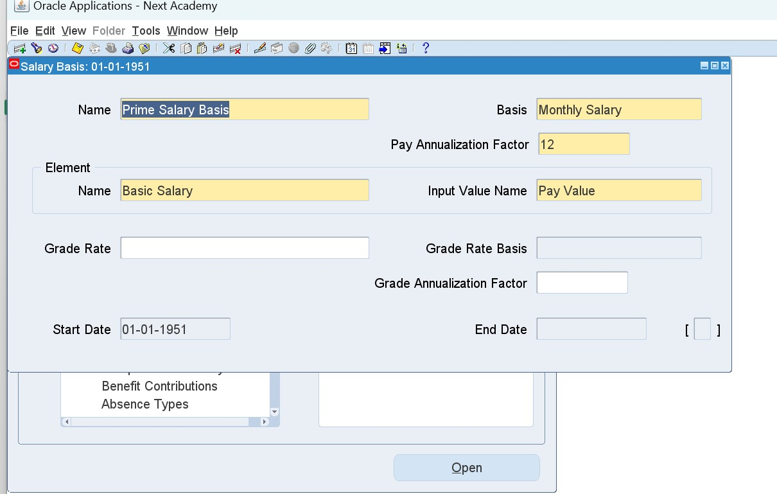
3. Define Salary Basis
HRMS > Total Compensation > Basic > Salary Basis
Add Salary Basis Name: Prime Salary Basis
Choose created element: "Basic Salary“
Input Value: Pay Value

Slide 76

Assign Salary to Employees

Slide 77
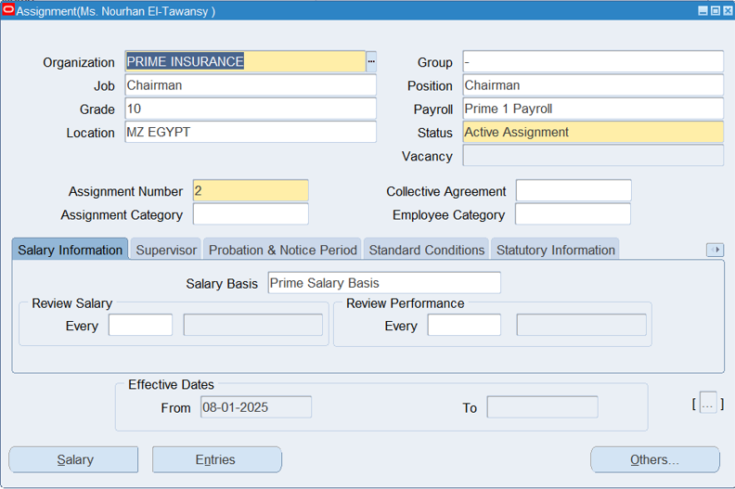
1. Choose Salary Basis
HRMS > People > Enter and Maintain > Assignment Window > Salary Information tab
Choose defined Salary Basis

Slide 78
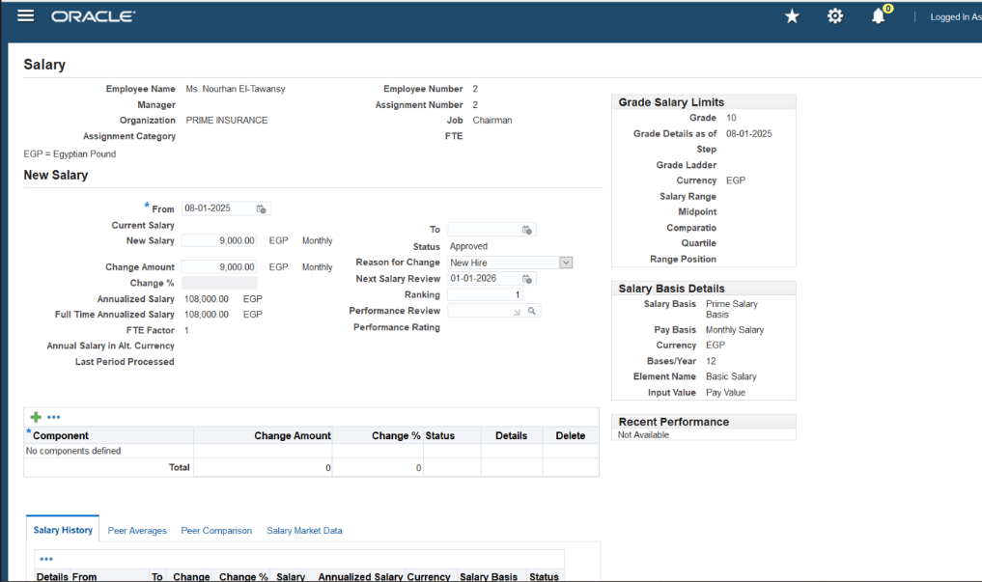
2. Add New Salary
HRMS > People > Enter and Maintain > Assignment Window > Salary Button
(Opens Salary Web Page)
From: Employment Effective Date
Add New Salary
Reason for Change - Lookups (Proposal Reason): New Hire
Next Salary Review Date

Slide 79

Press Apply - It reflects in Employee's Entries window (Assignment window)

Slide 80

Now it is added to Salary History grid

Slide 81
Edit Assigned Salary
HRMS > People > Enter and Maintain > Assignment Window > Salary Button
Salary History
Correct button
Edit amount
Apply
Delete Assigned Salary
Salary History (Move to the right and press on delete icon)

Slide 82

To Add a Salary Increase
HRMS > People > Enter and Maintain > Assignment Window > Salary Button
Add New Salary Button
Add the new date
Change % = Only the percentage and it will automatically get calculated
Reason for Change: COLA
Ranking:2

Slide 83

Remember to add an end date to the old salary
This new salary is proposed and should be approved

Slide 84

Approve Proposed Salary
HRMS > People > Salary Management
Ctrl + F11 to show proposed salaries
Review and press Approve

Slide 85

Salary History
HRMS > Fast Path > Salary History
Ctrl + F11 to show all salary changes

Slide 86

Salary Component
It is used when proposing more than one change on the same exact date.

Slide 87

Grade Rate
HRMS > Work Structure > Grade > Grade Rate
While adding salary basis grade should be identified, and when adding salary for an employee holding this grade, it should fall within this range.
Note: Grade Rate should be defined before assigning salary basis to employees.

Slide 88

System automatically generates a warning to prevent salary not within the grade rate.

Slide 89

Quick Pay Run (ONE EMPLOYEE)

Slide 90

HRMS > People > Enter and Maintain > Assignment > Others > Quick Pay
Run Type: Standard
Date Paid: Last date of the current month 31/03/2025

Slide 91

Element Selection Button opens Element Entries window to review included elements.
Start Run Button starts the quick pay run.

Slide 92

Once status is Complete, View Results Button gets activated to view the following:

Slide 93

1. Run Results

Slide 94

2. Balances
After running quick pay, Balances button shows all balances included.

Slide 95

To create you own balance lists ex. Earnings -Voluntary and Involuntary Deductions - Net Salary
HRMS > Total Compensation > Basic > Balance

Slide 96

1. Feeds Button is to review and add each element separately

Slide 97

2. Classifications Button is to add whole set of a category at one time into feeds. Ex. Earnings, deductions, etc.

Slide 98

3. Dimensions Button should be added after creating the balance. (Name: Assignment Run)

Slide 99

Re-run quick pay after repeating the process to create balances lists and this is how it looks:

Slide 100


Global Value
HRMS > Total Compensation > Basic > Global Value
Format: Upper Case with no spaces
Create once and edit its value in a future date and it shall keep history saved non-changed

